Slide 1

An Online Framework for User-Based Analysis of Maps in First Person Shooters
Marco Ballabio
Notes:
Memorize the introduction to thesis. Something like: “Buongiorno, sono Marco Ballabio e vi presento il mio lavoro di tesi”.

Slide 2

Level Design
Video games are interactive products.
Game Design
Level Design
Gameplay
Notes:
“Il Game Design definisce l’esperienza di gioco tracciando le regole e le meccaniche principali con cui si interfacciera il giocatore. Quanto definito dal Game Design si rispecchia nel Level Design, che tramite la creazione del mondo di gioco permette di concretizzare queste dinamiche. Infine dall’interazione del giocatore con il mondo di gioco nasce il gameplay.”

Slide 3
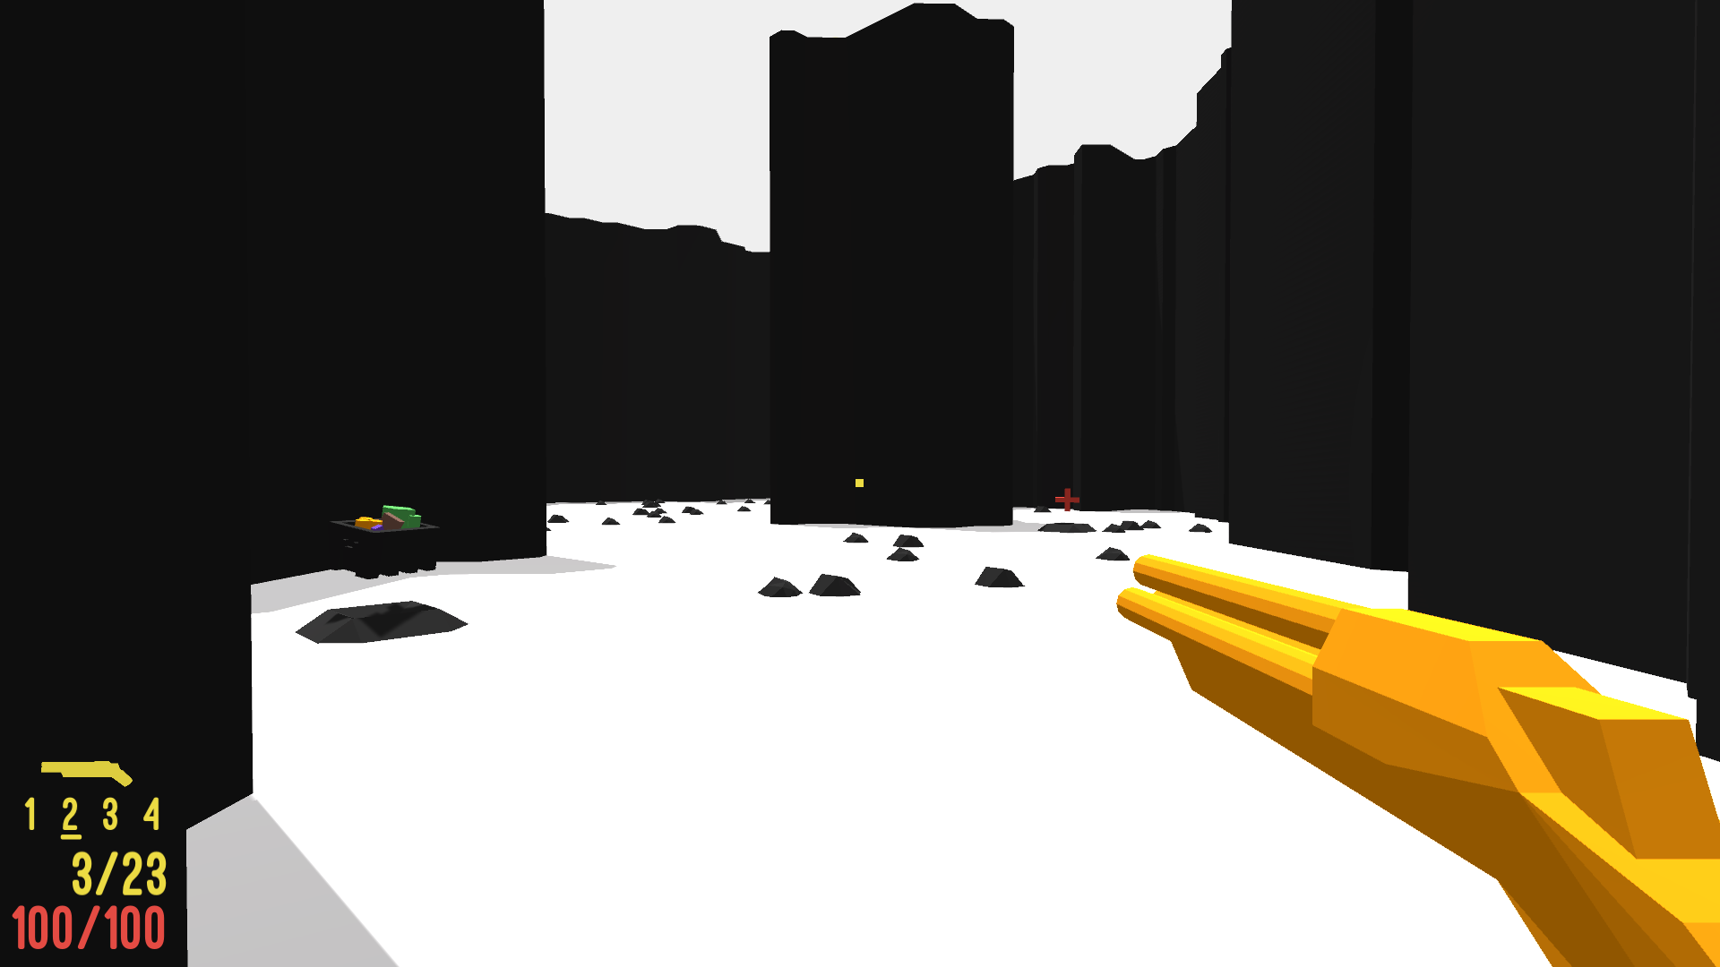
Notes:
“In questa tesi ci conetriamo sul genere degli Sparatutto in Prima Persona. [BREVE SPIEGAZIONE] In particolare ci concentriamo sugli FPS di tipo competitive. [BREVE SPIEGAZIONE] Quello che potete vedere è il gioco che fa parte del framework che abbiamo sviluppato e che vi mostrerò a breve.”

Slide 4
Research in Level Design
By the industry, Level Design is considered more as an art than a science.
Academic research aims at formalizing the discipline and at supporting the design process.
Notes:
“Il level design non è formalizzato in ambito industrial, ma si basa invece sull’esperienza e su regole empiriche. La ricercar tenta di formalizzarlo e di assisterlo.”

Slide 5
Map design and analysis framework
We developed a framework to assist research in this field.
Features of the framework:
Map import and generation.
Map analysis via graphs.
Collection of data from real users.
To test the maps, the framework includes a game with various game modes.
Notes:
“Il level design non è formalizzato in ambito industrial, ma si basa invece sull’esperienza e su regole empiriche. La ricercar tenta di formalizzarlo e di assisterlo.”

Slide 6



Map representation
The framework can import and export maps in two formats.
Matrix
Rooms

Slide 7
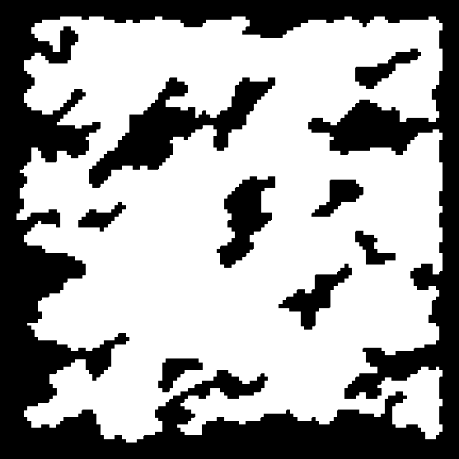
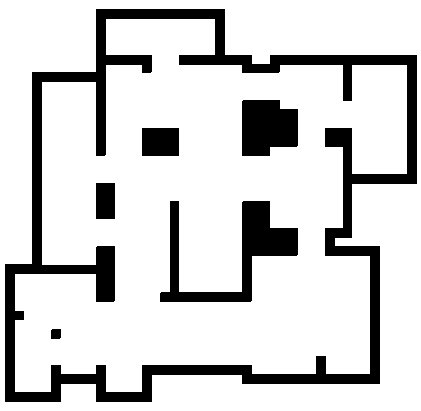

Map generation (single-level)
Cellular generator
Divisive generator
Digger generator

Slide 8
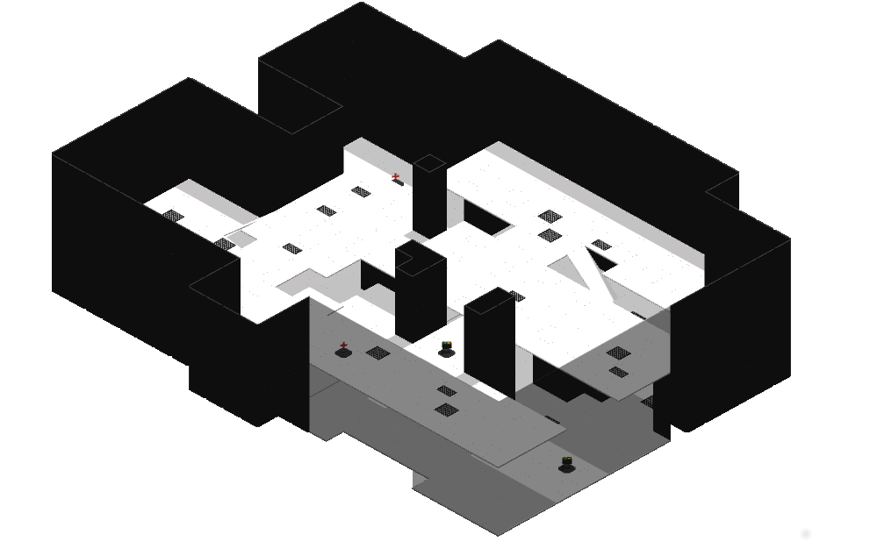
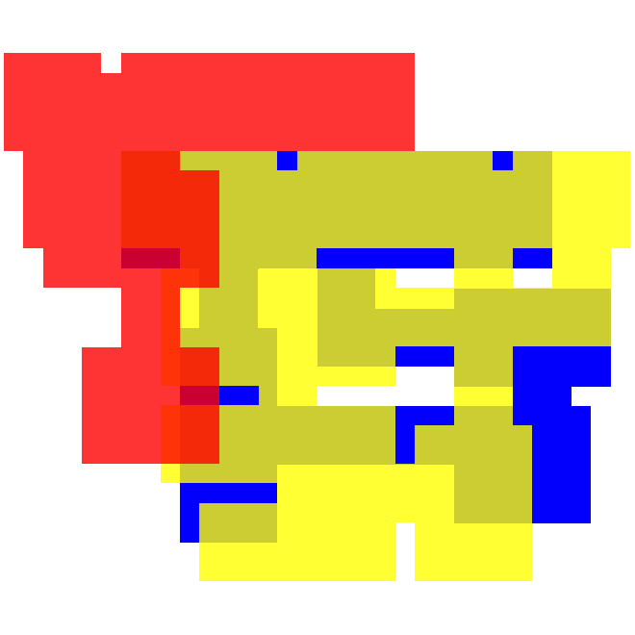
Map generation (multi-level)
Notes:
“Il framework supporta anche le mappe multi livello, generate combinando livelli singoli.” [ESSERE BREVI]

Slide 9
Graph-based map analysis
Generate different graphs highlighting different features of the map.
Extract layout information using Graph-Theory metrics.
Use this information to analyze the map or to place game elements.

Slide 10

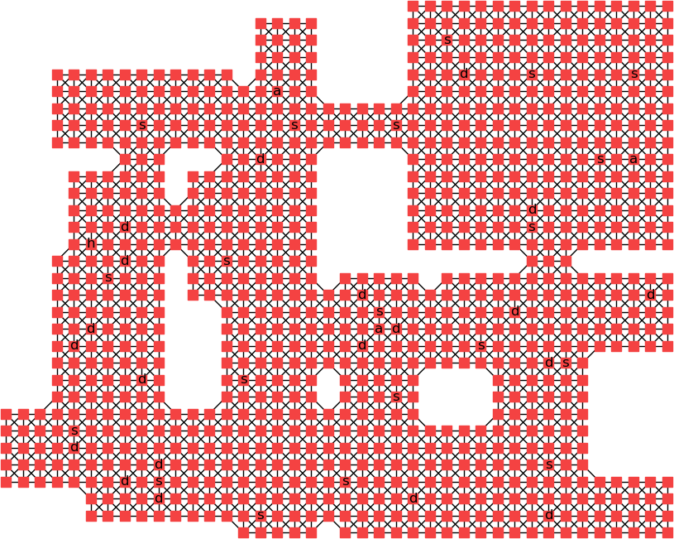
Graphs for single-level maps
Map
Tiles graph

Slide 11
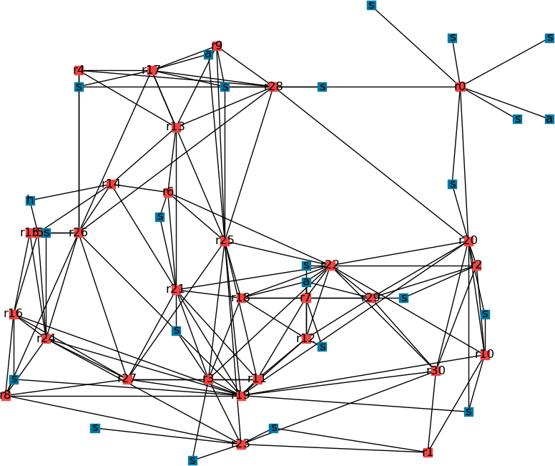
Graphs for single-level maps
Map
Rooms and game elements graph

Slide 12
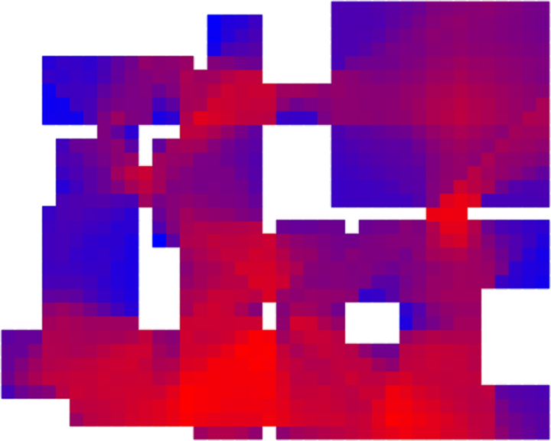
Graphs for single-level maps
Map
Visibility graph

Slide 13

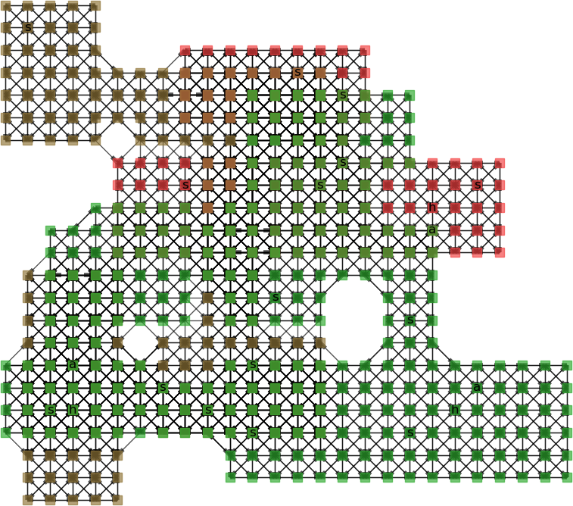
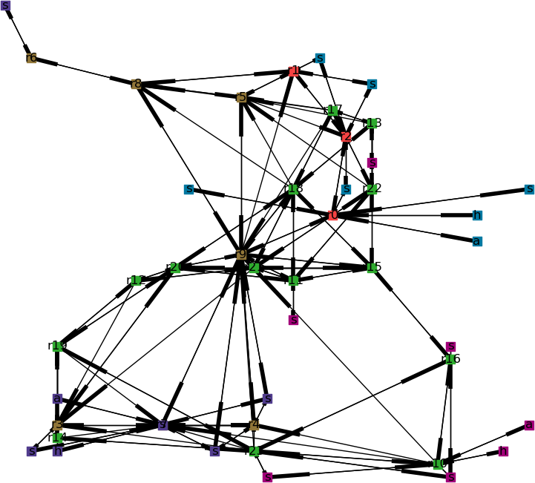
Graphs for multi-level maps
Map
Tiles graph
Rooms and game elements graph
Notes:
[BREVE]

Slide 14
Placement of game elements on the map
Rules are defined considering the up-player vs down-player dynamic.
The selection of the room and of the tile on which to place a game element is performed in two steps.
Each selection can be performed at random, uniformly or using an heuristic.

Slide 15

Selection by heuristic
Selection of a room:
$$r^{∗}=\arg{\max_{rεR}{(w_{D}×D\left(r\right)+w_{H_{e}}×H_{e}(r))}}$$
Selection of a tile:
$$t^{∗}=\arg{\max_{tεT}{(w_{v}×v\left(t\right)+w_{h_{w}}×h_{w}(t)+w_{h_{e}}×h_{e}(t)))}}$$

Slide 16
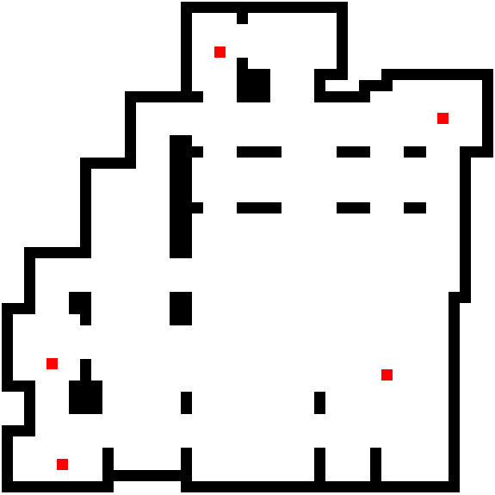

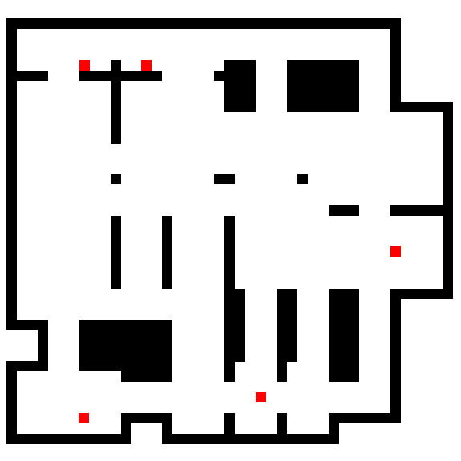
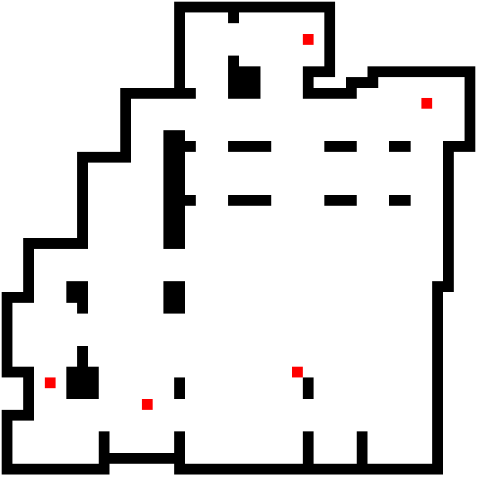
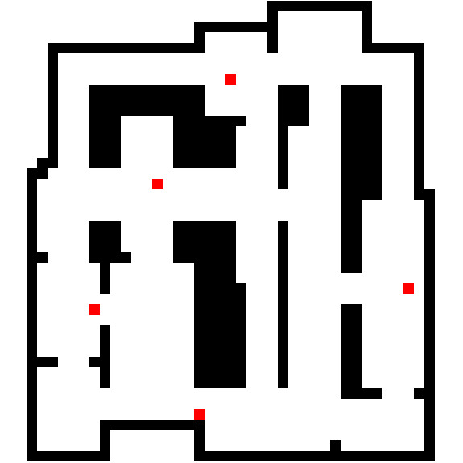
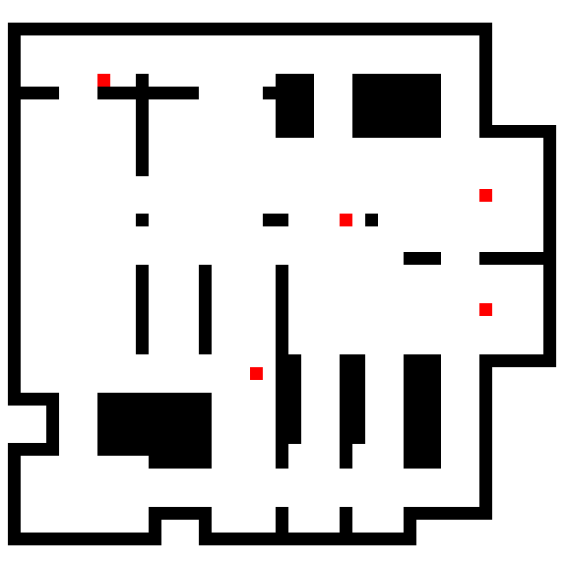
A case study: spawn points placement
Arena
Corridors
Intense
Heuristic
placement
Uniform
placement

Slide 17

Experimental results
Time between kills 26% higher for uniform approach with $α_{Wilcoxon, one tiled}=0.00203$
Average Kill Distance: 21% higher for uniform approach with $α_{Wilcoxon, one tiled}=0.01243$

Slide 18
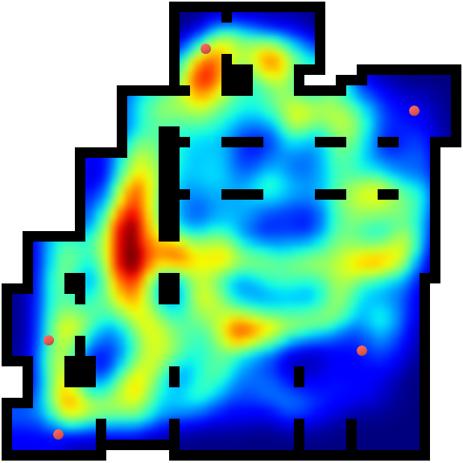
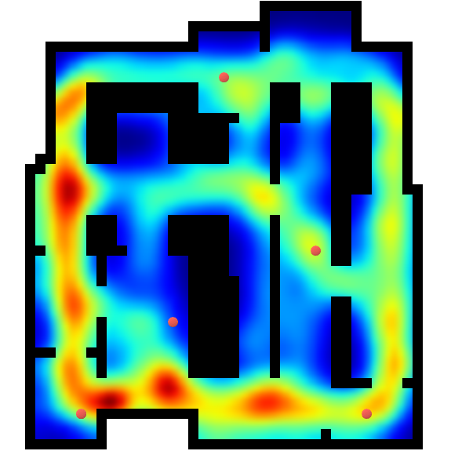
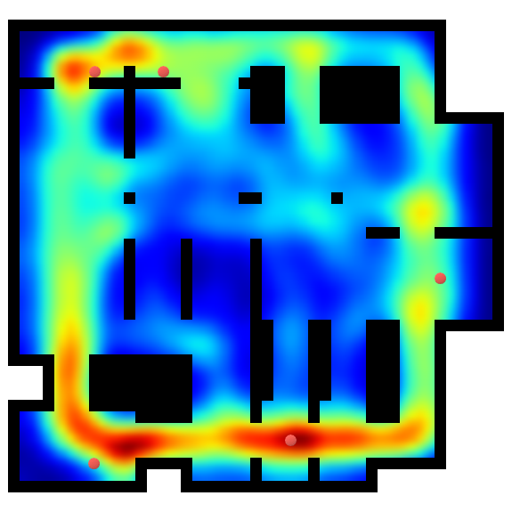
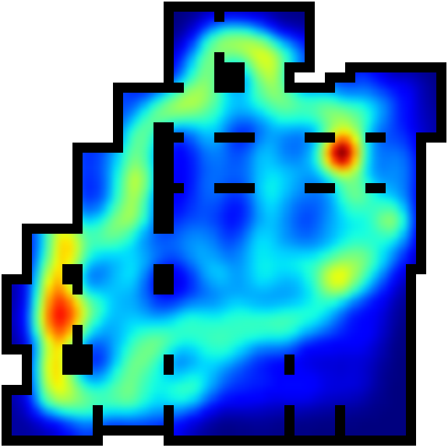
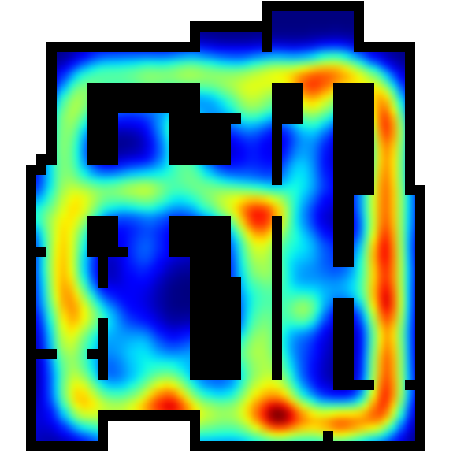
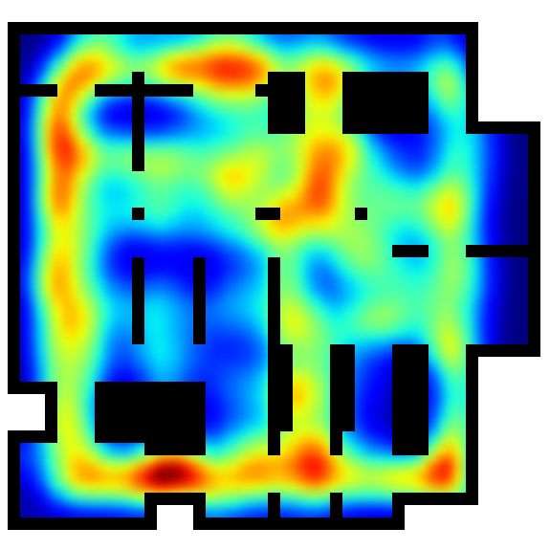
Experimental results
Heuristic
placement
Uniform
placement

Slide 19
Conclusions
The framework is effective in collecting data.
Graph Theory allows a new and interesting approach to Level Design analysis.
Heuristic placement based on Graph Theory allows to effectively place game elements considering their features and the topology of the map.

Slide 20
Future developments
Multiplayer and AI support.
Heuristics for weapon placement.
Design pattern analysis.

Slide 21
Thank you for your attention!

